Slide 1

Green Pace
Security Policy Presentation
Developer: Alex Sandoval

Slide 2

OVERVIEW: DEFENSE IN DEPTH
The policy is designed to provide the utmost security for protecting the network by utilizing several security measures and controls throughout a computer network, using logical overlapping techniques to protect confidentiality, integrity, and availability of network data.

Slide 3
THREATS MATRIX
The threat matrix diagram provides 4 examples of risk assessment possibilities, the chances of occurrence, and the urgency to make corrections.
Likely STD-001-CPP | Priority STD-007-CPP
Low priority STD-009-CPP | Unlikely STD-006-CPP

Slide 4
10 PRINCIPLES
Validate Input Data – Certify input from all untrustworthy data sources.
Heed Compiler Warnings - Compile code using the highest maximum warning level possible for your compiler by changing the code
Architect and Design for Security Policies - Build software architecture and layout your software to execute and administer security procedures.
Keep It Simple - Keep the design as plain and small-scale as possible. Complicated designs enhance the probability that mistakes will be made in their operation, construction, and purpose.
Default Deny - Base access rules on permission instead of exclusion.
Adhere to the Principle of Least Privilege - All processes should perform with the minimum set of privileges essential to carry out the job.
Sanitize Data Sent to Other Systems - Clean all data passed to intricate subsystems such as command shells, relational databases, and commercial off-the-shell (COTS) components.
Practice Defense in Depth - Control risk with numerous defensive tactics that can protect if one layer of defense turns out to be insufficient, an additional layer of defense can stop a security flaw from becoming an exploitable liability and limit the effects of a successful exploit.
Use Effective Quality Assurance Techniques - Fuzz testing, penetration testing, and source code audits ought to be included as part of an effective quality assurance program.
Adopt a Secure Coding Standard - Create and employ a secure coding guideline for your target development language and platform.

Slide 5
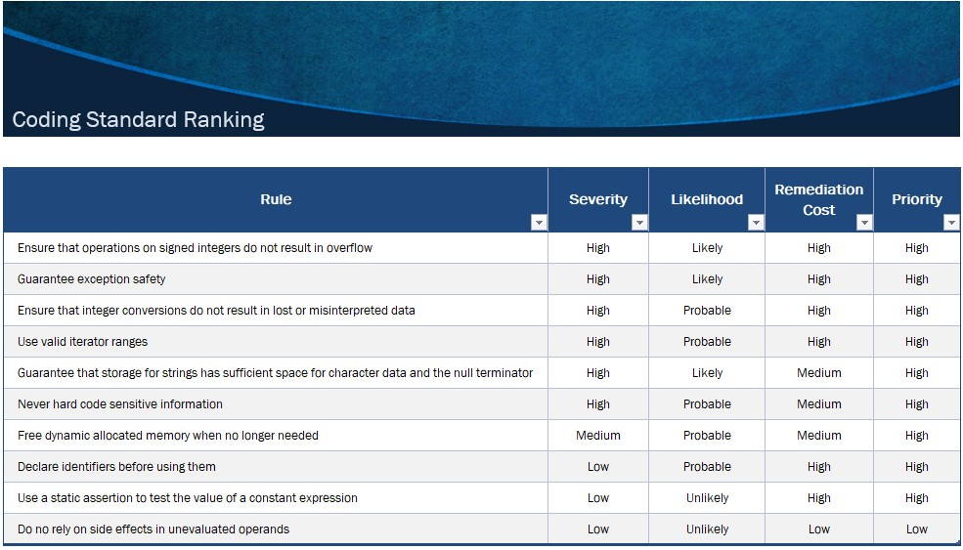
CODING STANDARDS
The 10 coding standards are ranked in order of most importance. The severity, likelihood, remediation cost, and priority was taken into consideration of how the codes were ranked from most to least severe.

Slide 6
ENCRYPTION POLICIES
Encryption in rest - Sensitive data that is stored in a restful state needs to have encryption applied for defense from any unauthorized access.
Encryption at flight - Encrypted data that moves across the network is considered data in flight. The encryption plays an important role of concealment of data between the sending party and receiving party.
Encryption in use - Data that is being accessed by a user or application is data in use. This form of data is the most vulnerable because the data is in a clear text form in the memory for the time of use by user or the application.

Slide 7
TRIPLE-A POLICIES
Authentication - Authentication offers a means of distinguishing an individual. A common practice is by having the user submit a username and password that has been authenticated for validity before gaining entry to the network.
Authorization - Each user is granted a certain amount of authorization on what can be performed on the network such as installing applications or access to sensitive directory files. The importance of authorization is that not every user will have full access to the network but enough to fulfill their job requirements.
Accounting - Accounting is the collecting and logging of information of a device on a network. The information is then sent back to a server for the purpose of auditing, billing, and reporting. The benefit of accounting is being able to examine the logs of all management sessions used to access the network.

Slide 8
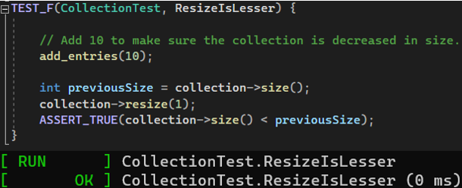
Unit Testing
Unit test to decrease the collection.

Slide 9
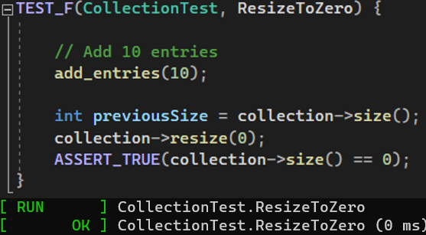
Unit Testing (cont.)
Unit test to verify resizing decreases the collection to zero.

Slide 10
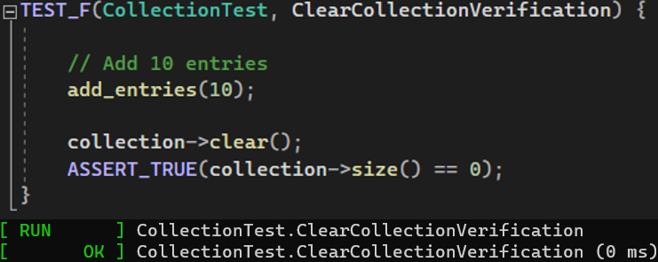
Unit Testing (cont.)
Unit test to verify clearing of the collection.

Slide 11
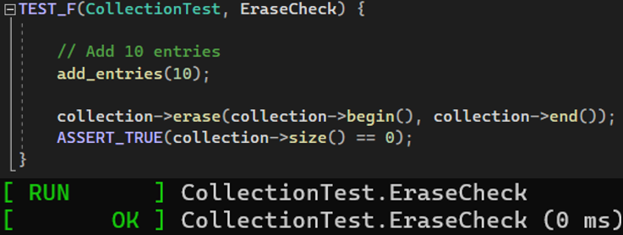
Unit Testing (cont.)
Unit test to verify erase begin/end erases the collection.

Slide 12

AUTOMATION SUMMARY

Slide 13
TOOLS
DevSecOps Pipeline - The procedure of creating vital security standards in the DevOps cycle by working in partnership with the information technology security group, operations group, and the specific software developers’ team. This procedure avoids the mistake of adding security at the end of the software development lifecycle.
External tools - DevSecOps tools are used in the code stage to assist developers in creating better safeguarded code. External tools support with significant code-phase defense procedures that involve static code testing and analysis, code audits, and unit and integration tests to detect and monitor for vulnerabilities.

Slide 14
RISKS AND BENEFITS
The risks and benefits involved if you act now or wait to include security.
Wait Risk – The risk of not including security is the chance of having attackers exploit vulnerabilities within the code and network, which has a huge significance in cost, time, and reputation.
Wait Benefit – The benefit of not including security is the cost and time saved for the company.
Act Now Risk – Extensive costs and time to incorporate security which can affect project and budget constraints.
Act Now Benefit – The benefit of including security is the removal of unnecessary ramifications to the network vulnerabilities, cost of time and finances to repair the exploits, and damaged reputation.

Slide 15
RECOMMENDATIONS
Common gaps in the security policy
Not validating input data.
Not heeding compiler warnings.
Not keeping the design plain and small-scale as possible.
Not adhering to the principle of least privilege.
Not practicing defense in depth.
Not adopting a secure coding standard.

Slide 16
CONCLUSIONS
Standards that should be addressed to prevent future problems.
Unpreparedness - Neglecting to anticipate and act to breaches will come at a great cost as companies strive to return to business as usual.
Lack of monitoring - Make certain that threats are discovered as soon as possible. Companies must have the proper monitoring equipment to search for and flag unusual behavior on the network. This will diminish the company's exposure to attacks.
Third Party/Vendor Risks - Companies who work with third party vendors need make sure they are utilizing vigorous cyber security measures and policies. Companies must regularly review and have ongoing assessments of the protection points of these external parties to prevent attackers from exploiting gaps to get into the company's network.
Employee Risk - Spiteful employees could leak out sensitive data. An unknowing employee could accidentally open a door for attackers by what they download or open in emails. Employees who are security minded can look out for dangerous applications, emails, spiteful employees, and can be a company’s best first defense for protection.

Slide 17
REFERENCES
10 Common Gaps in Cyber Security. (2022, December 01). Retrieved from Chubb.com: https://www.chubb.com/th-en/articles/10-common-gaps-in-cyber-security.html
Argintaru, D. (2021, July 22). Data Encryption - Data at Rest vs In Transit vs In Use Options. Retrieved from mimecast.com: https://www.mimecast.com/blog/data-in-transit-vs-motion-vs-rest/
Seacord, R. C. (2013). Secure Coding in C and C++ (2nd ed.). Retrieved from https://mbsdirect.vitalsource.com/reader/books/9780132981972/
SEI CERT C++ Coding Standard. (2020, May 29). Retrieved from wiki.sei.cmu.edu: https://wiki.sei.cmu.edu/confluence/pages/viewpage.action?pageId=88046682
What Is AAA? (2022, December 01). Retrieved from arubanetworks.com: https://www.arubanetworks.com/techdocs/ClearPass/6.7/Aruba_DeployGd_HTML/Content/802.1X%20Authentication/About_AAA.htm
Zettler, K. (2022, December 01). DevSecOps Tools. Retrieved from atlassian.com: https://www.atlassian.com/devops/devops-tools/devsecops-tools

